Slide 1
H-2A Workers and Eligibility for Health Insurance
Alexis Guild
Senior Health Policy Analyst
Farmworker Justice

Slide 2
Farmworker Justice
Farmworker Justice is a nonprofit organization that seeks to empower farmworkers to improve their living and working conditions, immigration status, health, occupational safety, and access to justice
www.farmworkerjustice.org

Slide 3
Agenda
Overview of the H-2A program
H-2A Eligibility for Health Insurance
Special Considerations
Questions/Resources

Slide 4
What is the H-2A Program?
H-2A workers are in the U.S. on temporary non-immigrant visas
Visas are tied to employers who sponsored them
Positions are up to 10 months, certified by the U.S. Dept. of Labor
Employers must provide a required wage rate, housing, transportation to and from their home country, and workers’ compensation insurance
The program is growing: In FY 2016, 165,000 were certified, up from 48,000 in FY2005.
Top 10 states (in order):
Florida - 22,828
North Carolina – 19,786
Georgia – 17,392
Washington – 13,689
California – 11,106
Louisiana – 8,301
Kentucky – 6,779
New York – 5,522
Arizona – 5,391
South Carolina – 3,986
(source: U.S. Department of Labor, Office of Foreign Labor Certification)

Slide 5
Who are H-2A Workers?
Most H-2A workers are young men between 18 and 35 years old. Vast majority are from Mexico
H-2A workers from Central America and Haiti may be on the rise
Rise in H-2A labor contractors

Slide 6
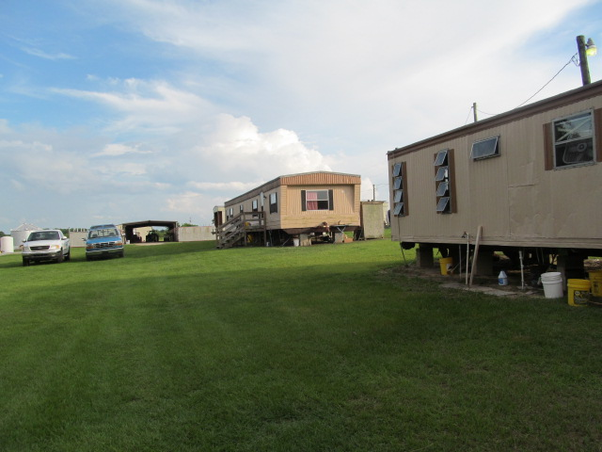
Where are H-2A workers – Housing
Employers are required to provide housing to H-2A workers
H-2A workers tend to be housed separately from other workers
Types of H-2A housing:
Barracks
Trailers
Motels
Address and directions to H-2A housing can be found in job order (accessible via DOL website)

Slide 7
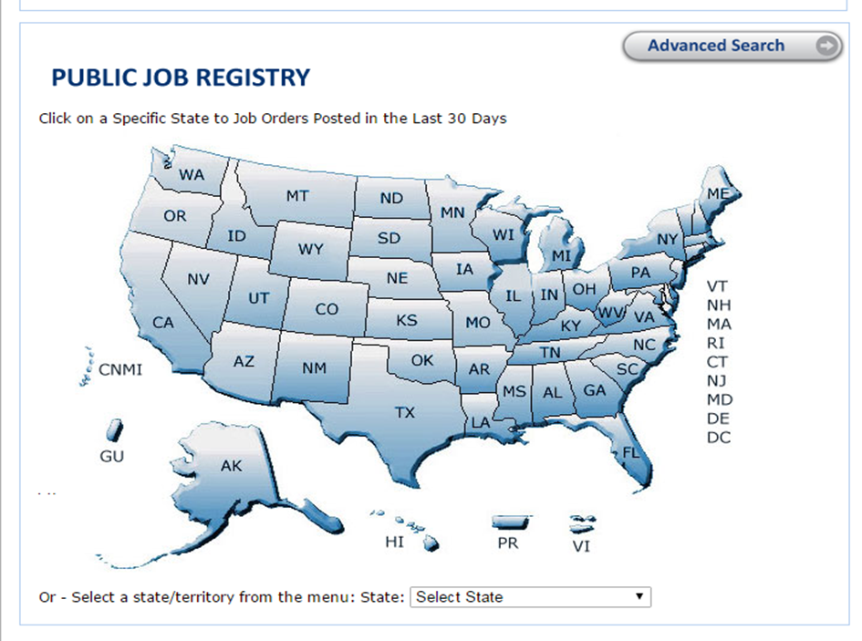
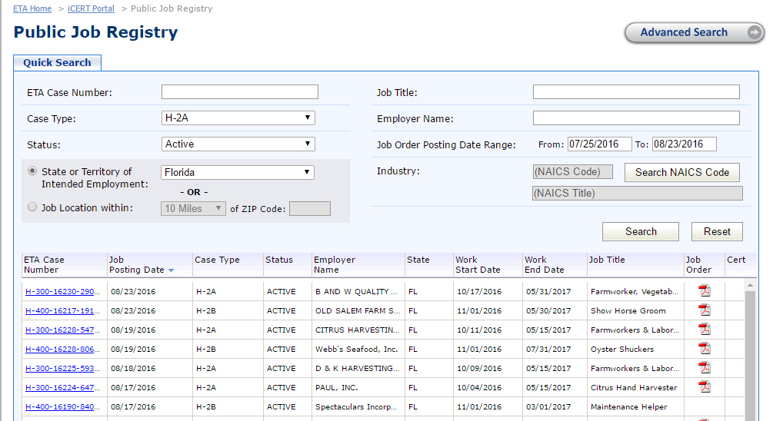
Finding H-2A Workers in Your Area
To find out where H-2A worker are in your area…
Go to the Dept. of Labor’s iCERT portal - https://icert.doleta.gov/
Click on your state
Fill out the “Quick Search” on
public job registry
Click on job order

Slide 8
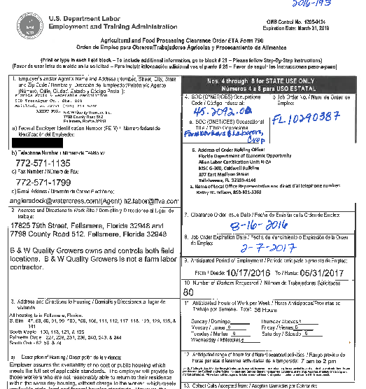
Sample Job Order

Slide 9
Test your knowledge (#1)
How do employers apply to participate in the H-2A program?
Which states receive the most H-2A workers?
How can you find out where H-2A workers are living in your area?

Slide 10
Barriers to General Health Care Access
Workers have limited access to clinics
More isolated than general farmworker population
Rely on employer for transportation
Workers may be reluctant to go to a doctor or access medical care
Fear of employer retaliation (especially for work-related injuries)
May not trust health care provider or outreach worker
Follow-up treatment may be difficult, especially once they leave the U.S.
Notes:
10

Slide 11
Rights and Responsibilities of H-2A Workers under the ACA
Eligible for health insurance through the marketplaces
Eligible for financial assistance and cost-sharing reductions to lower the cost of health insurance
The “individual mandate” applies!
Must have comprehensive health insurance during their time in the U.S. or will be subject to a tax penalty, unless qualify for an exemption

Slide 12
How are H-2A Workers’ Rights and Responsibilities under the ACA Different from Other Workers?
Not eligible for Medicaid
H-2A workers are eligible for tax credits below 100% FPL
Only responsible for health insurance coverage during their time in the U.S.
Qualify for “certain noncitizen” exemption (exemption “C”) during the months they are outside of U.S.

Slide 13
Note about Workers’ Compensation
Workers’ compensation ≠ Minimum essential coverage
Workers must have comprehensive health insurance, either from their employer or through the marketplace, to comply with the individual mandate
Notes:
H-2A workers are covered under workers’ compensation regardless of the state law (states vary on their requirements of workers’ compensation for agricultural workers). More information about workers’ compensation can be found at http://www.farmworkerjustice.org/sites/default/files/Workers%20Comp%20Guide%20FINAL%20%281%29.pdf.
Workers may be confused about the difference between workers’ compensation and comprehensive health insurance.

Slide 14
Test Your Knowledge (#2)
Are H-2A workers eligible for health insurance and financial assistance in the marketplace?
At what FPL are H-2A workers eligible for APTCs?
Is workers’ compensation insurance considered minimum essential coverage?

Slide 15
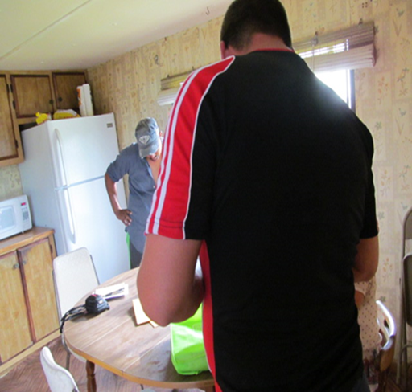
Special Considerations
Many H-2A workers arrive outside of open enrollment
Eligible for 60-day Special Enrollment Period that starts the day they enter the U.S.
Workers must disenroll from health insurance before leaving the U.S.
Migrant H-2A workers who work for labor contractors
Migrant workers qualify for “permanent move” SEP (see guidance from CMS)
Documentation requirements

Slide 16
Special Considerations - Household
Workers will likely not have utility bills, leases, or other documents related to residence
Workers from Mexico may be able to claim dependents in Mexico as part of their household size on their marketplace application
Dependents must meet IRS definitions
They are NOT eligible for health insurance
Dependents need ITINs (Individual Tax Identification Numbers)
Mexican consulate, legal services can assist Mexicans with this process

Slide 17
Special Considerations - Exemptions
Certain noncitizen exemption
If worker files taxes as non-resident alien
H-2A workers can claim this exemption for the months they are not in the U.S.
Other exemption H-2A workers may qualify for:
Affordability
Short Coverage Gap
Below tax filing threshold
Hardship

Slide 18
Special Considerations – Employer-provided Health Insurance
Seasonal worker exemption
Large employers whose workforce over the 50 FTE threshold are seasonal workers who work for fewer than 120 days in a calendar year ARE NOT included in the employer mandate
H-2A workers are counted towards the employer mandate
Newly hired seasonal employees vs. non-variable hour employees
Seasonal employees = customary employment is 6 months or less
Employers can use an initial measurement period between 3 and 12 months to determine if the newly-hired employee works on average 30 hours/week
Workers declining employer offers of health insurance

Slide 19
Test Your Knowledge (#3)
Are H-2A workers eligible for a Special Enrollment Period?
What are some special considerations when enrolling H-2A workers in health insurance?

Slide 20
Challenges to Enrollment
Lack of knowledge about ACA
Confusion about workers’ compensation vs. comprehensive health insurance
Cannot begin the enrollment process until they arrive in the U.S. The majority arrive after the end of open enrollment.
Limited number of application assisters and many workers to enroll in a short period of time
By the time they arrive in the area where they will work and live, have fewer than 60 days to enroll
Long working hours with irregular schedules and limited flexibility
Potential data matching issues

Slide 21
Strategies for H-2A Worker Enrollment
Partner with other organizations that work with H-2A workers
Legal services organizations, community-based organizations, Mexican Consulates
Partner with local growers
Arrange visits to provide information about the ACA and the role of the assister
Some assisters have been able to work with growers to arrange transportation to enrollment sites or enrollment events at farms.
Growers may not be aware that H-2A workers have rights and responsibilities under the ACA

Slide 22
Strategies for H-2A Worker Enrollment
Ensure sustained on-site in-person assistance
Assisters should be flexible in scheduling appointments, providing enrollment assistance at the workers’ homes at nights or on Sundays
Enrollment requires intensive follow-up with multiple visits pre- and post-enrollment*
Notes:
A health center in North Carolina enrolled 700 H-2A workers, which required approximately 7000 touches, or about 10 touches per worker, including pre- and post-enrollment.

Slide 23
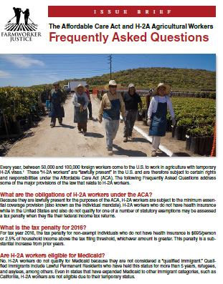
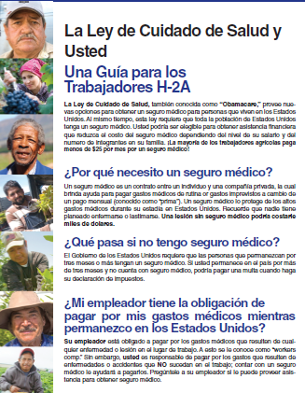
Resources
ACA Guides – available in Spanish, English, and Haitian Creole
H-2A workers
Employer-provided health insurance
Enrollment
Health Insurance Requirement
FAQ: H-2A workers and the ACA
H-2A Fact Sheet
North Carolina H-2A video

Slide 24
Questions

Slide 25
Thank you!
Alexis Guild
Senior Health Policy Analyst
Farmworker Justice
aguild@farmworkerjustice.org
202-372-7422

