Slide 1
¡Juntos Nos Movemos!
Parents and Kids Making the Time to Move Together!
A curriculum developed by Farmworker Justice and National Migrant and Seasonal Head Start Collaboration Office
This publication is supported by the Health Resources and Services Administration (HRSA) of the U.S. Department of Health and Human Services (HHS) as part of an award totaling $450,000 with 0% financed with non-governmental sources. The contents are those of the authors and do not necessarily represent the official views of, nor an endorsement by, HRSA, HHS, or the U.S. Government. For more information, please visit HRSA.gov

Slide 2
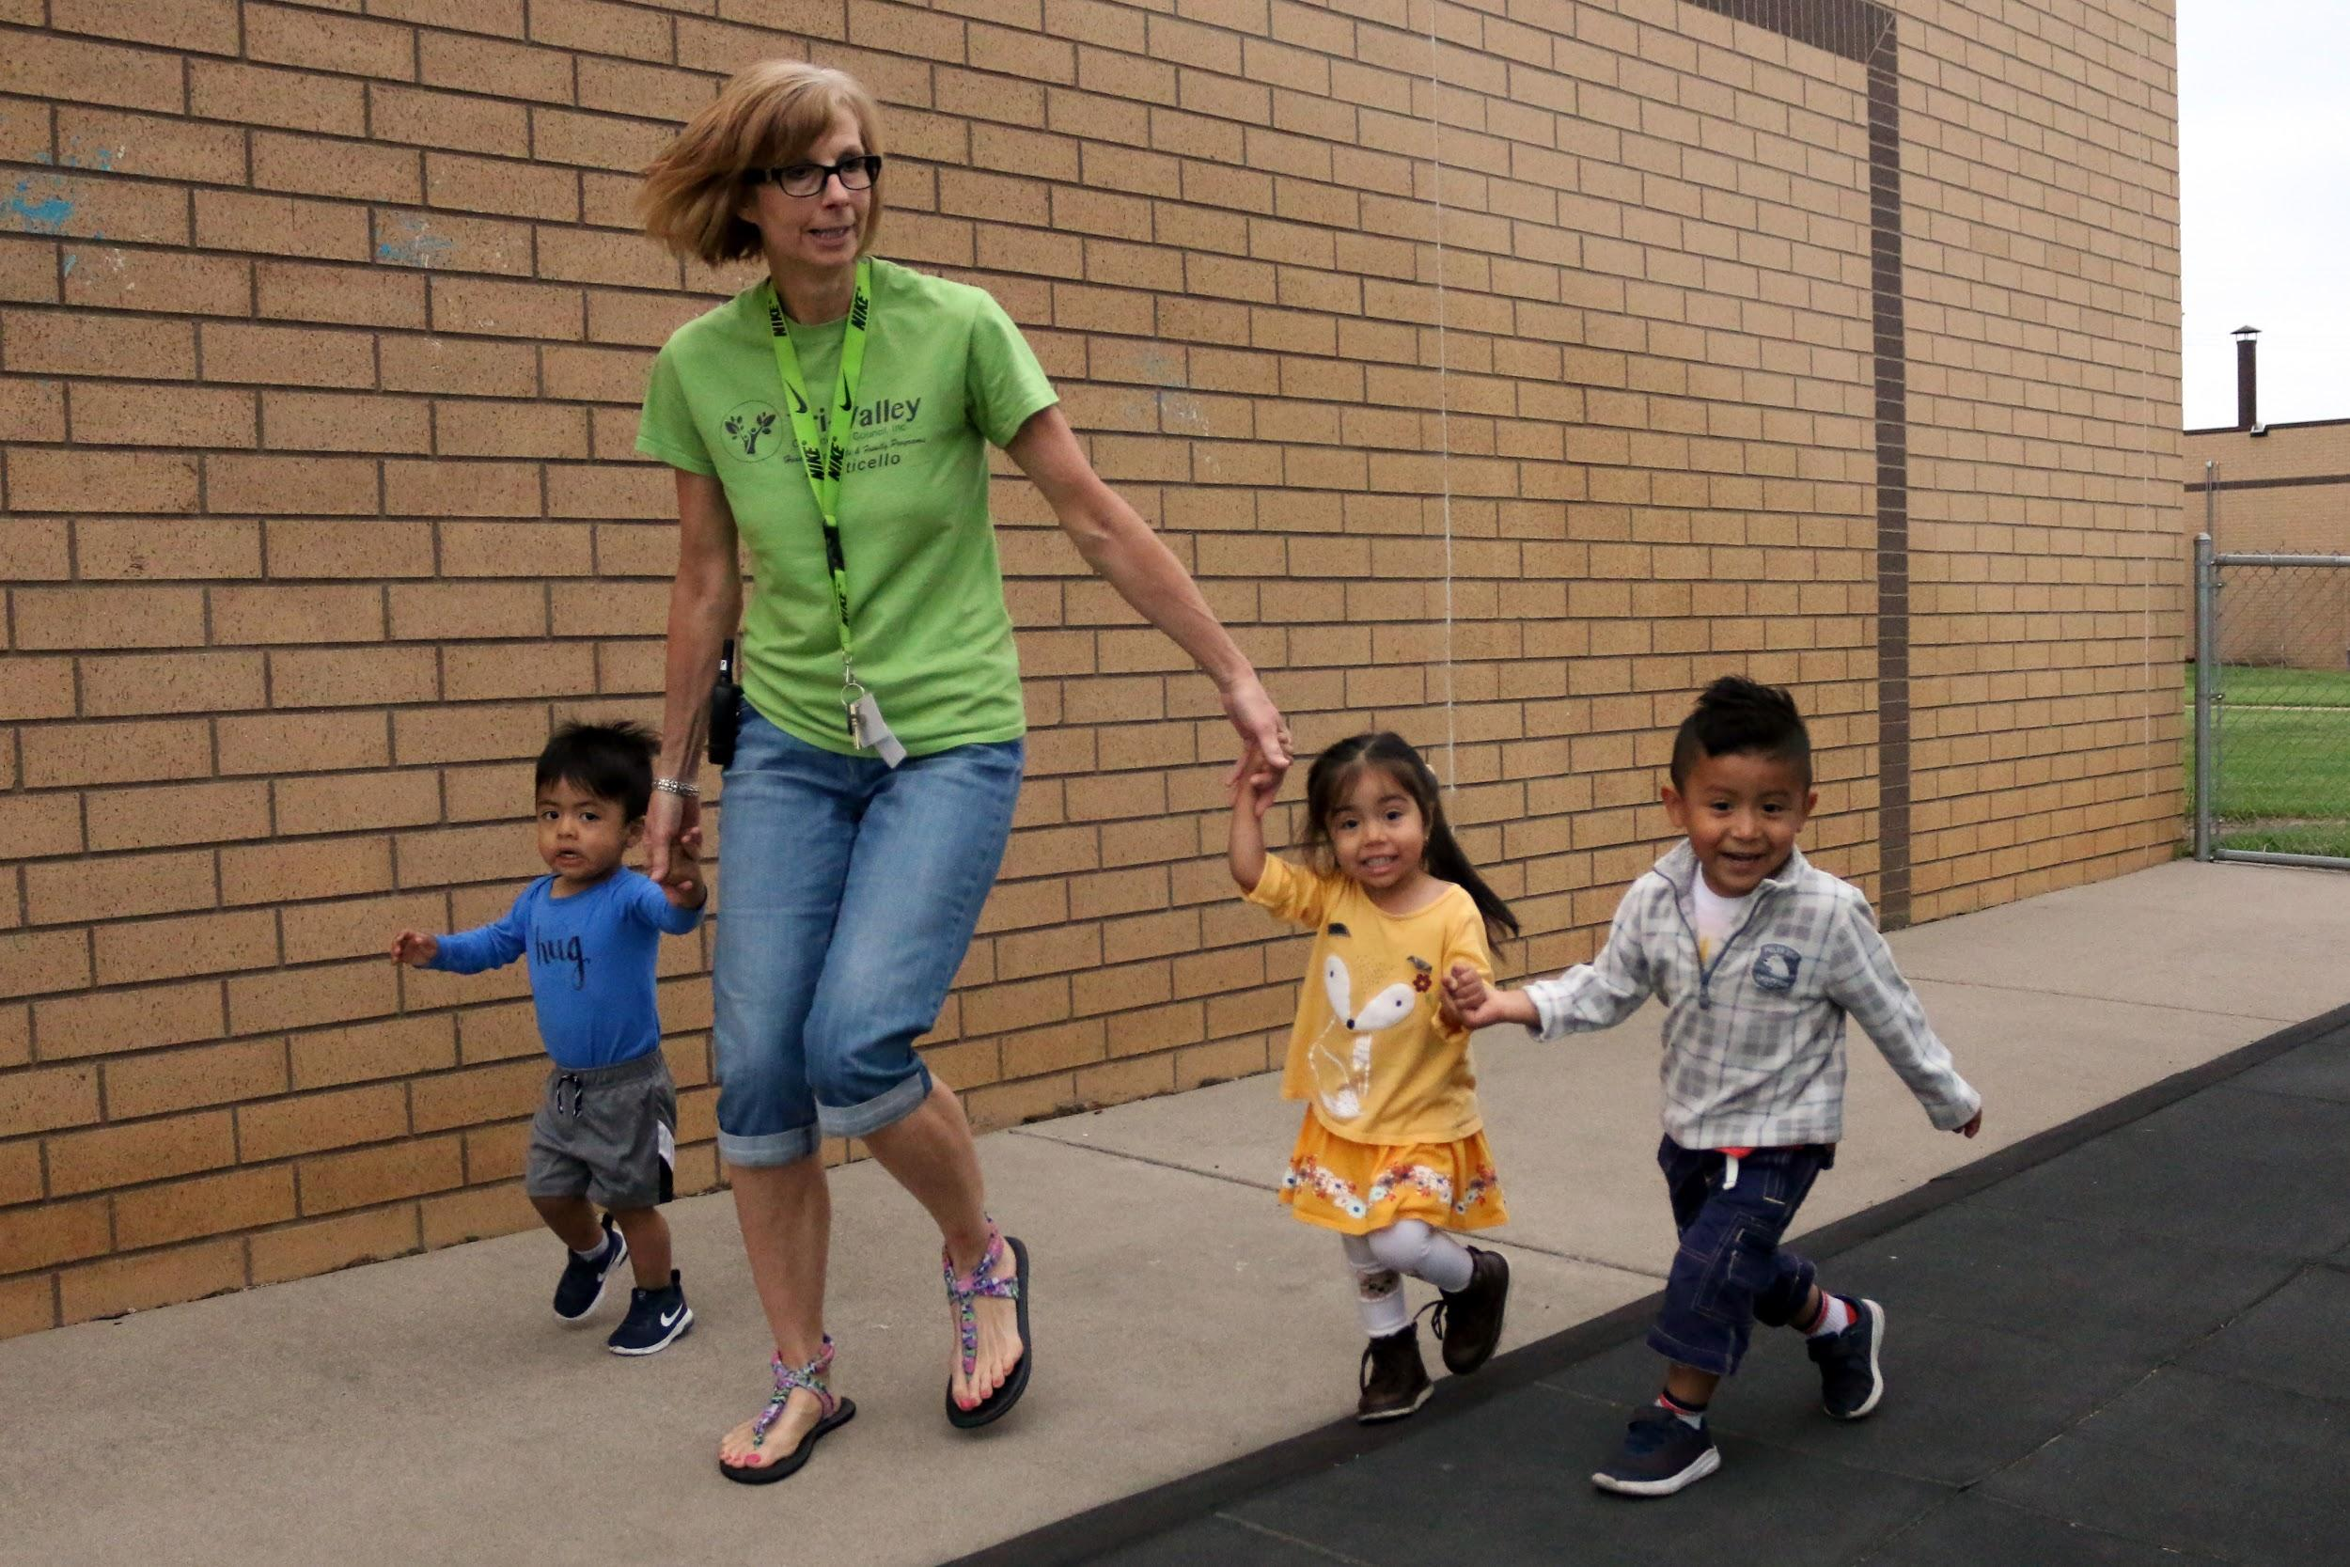

Slide 3
Icebreaker Activity:
Let’s move!
Materials
-Music (from your phone, a radio, etc.)
Have all participants gather in a circle.
Begin the music.
Ask each participant to think of a movement or dance move.
One at a time, have each participant demonstrate their movement.
Starting with the person on your left, ask them to perform their movement.
Then the second person performs the first person’s movement and their own.
Then the third person performs the first and second person’s movement.
This continues around the circle until it reaches the last person. Then have the first person do everyone’s movement all over again.
For extra fun, make the challenge that all the movements have to happen before the end of the song.

Slide 4
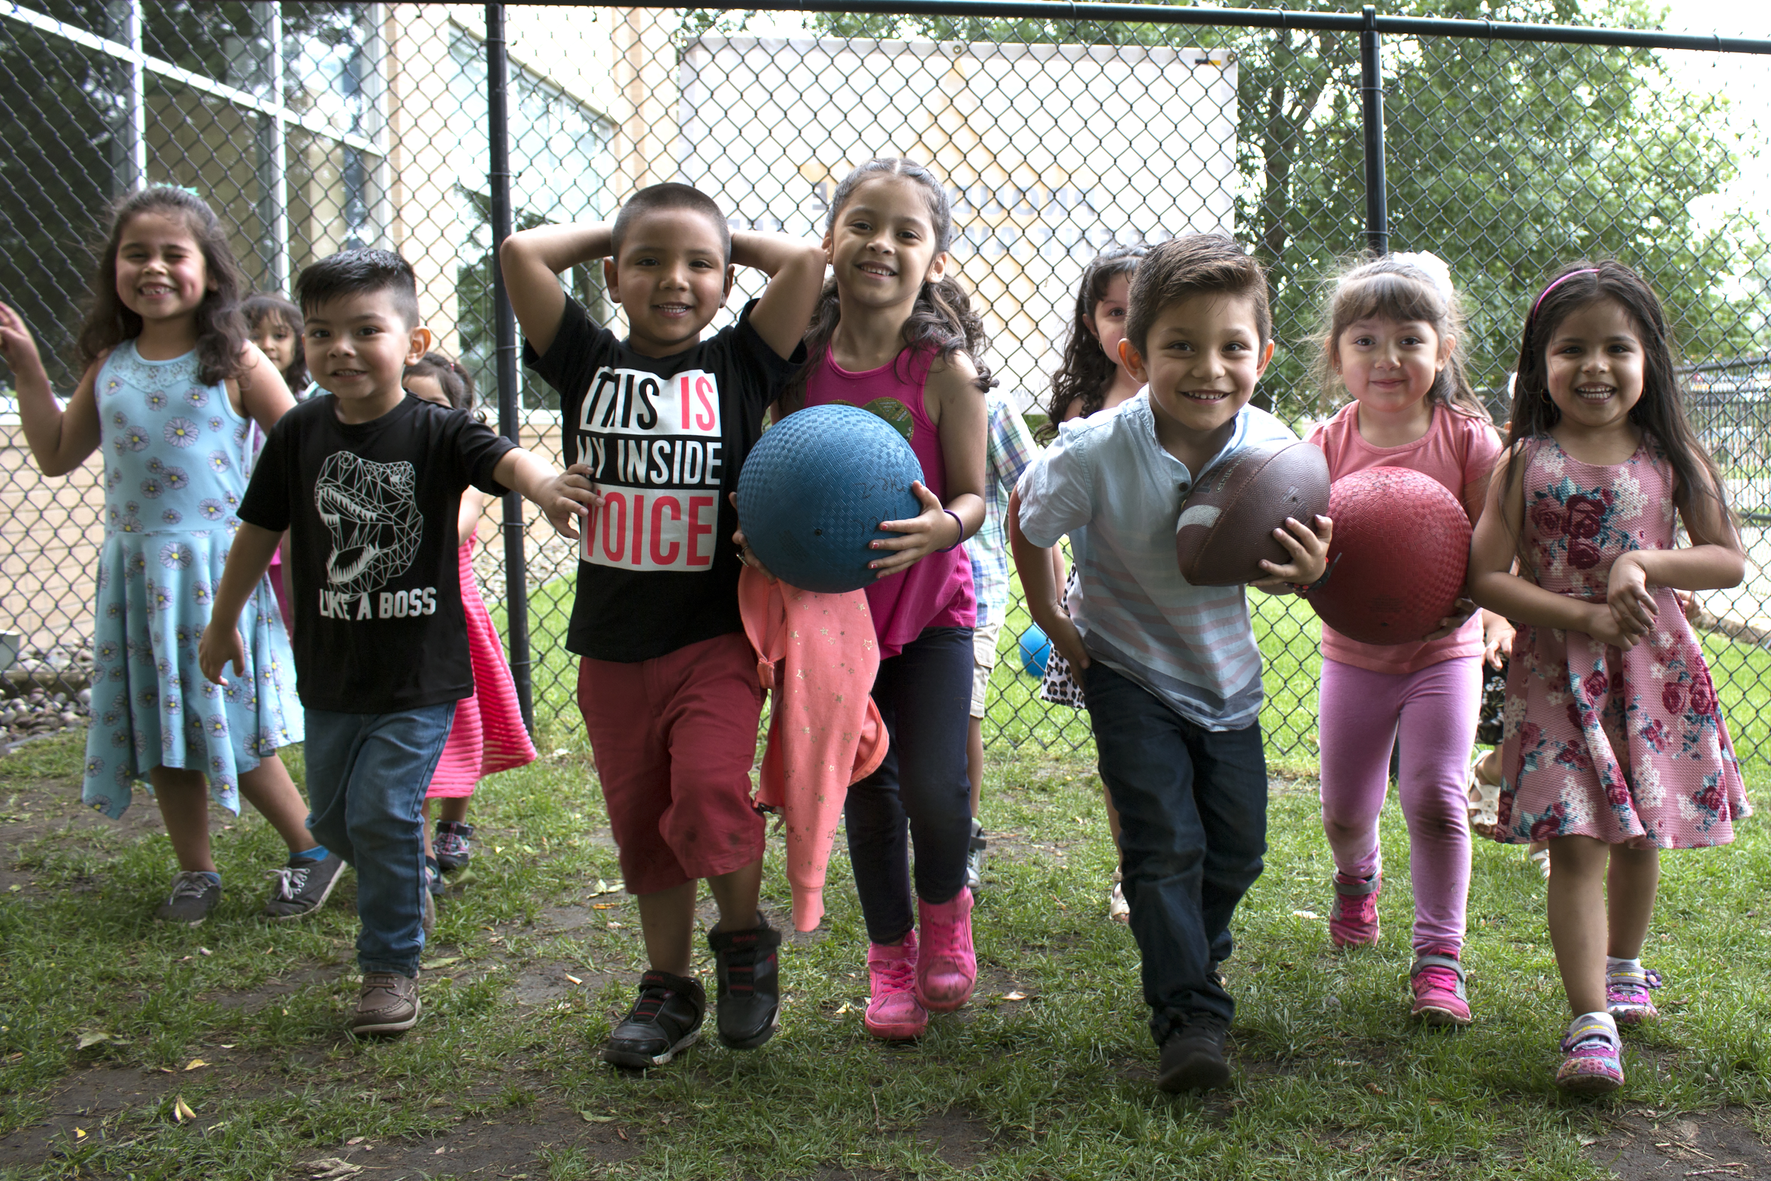
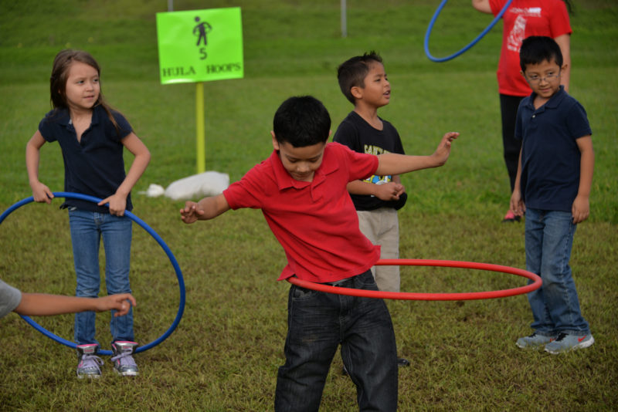

Slide 5
Introductions
Materials
-Printed questions, cut into strips
-Hat, box, or bag to hold the questions
Gather participants in a circle.
Pass around a hat filled with the following questions:
What is your favorite thing to do with your child?
What was your favorite physical activity as a kid?
Why is physical activity important for you and your family?
What is your favorite meal to cook with your child?
What was your favorite game to play as a child?
Have participants reach into the hat, choose a question, answer it for the group, and put the question back into the hat.

Slide 6
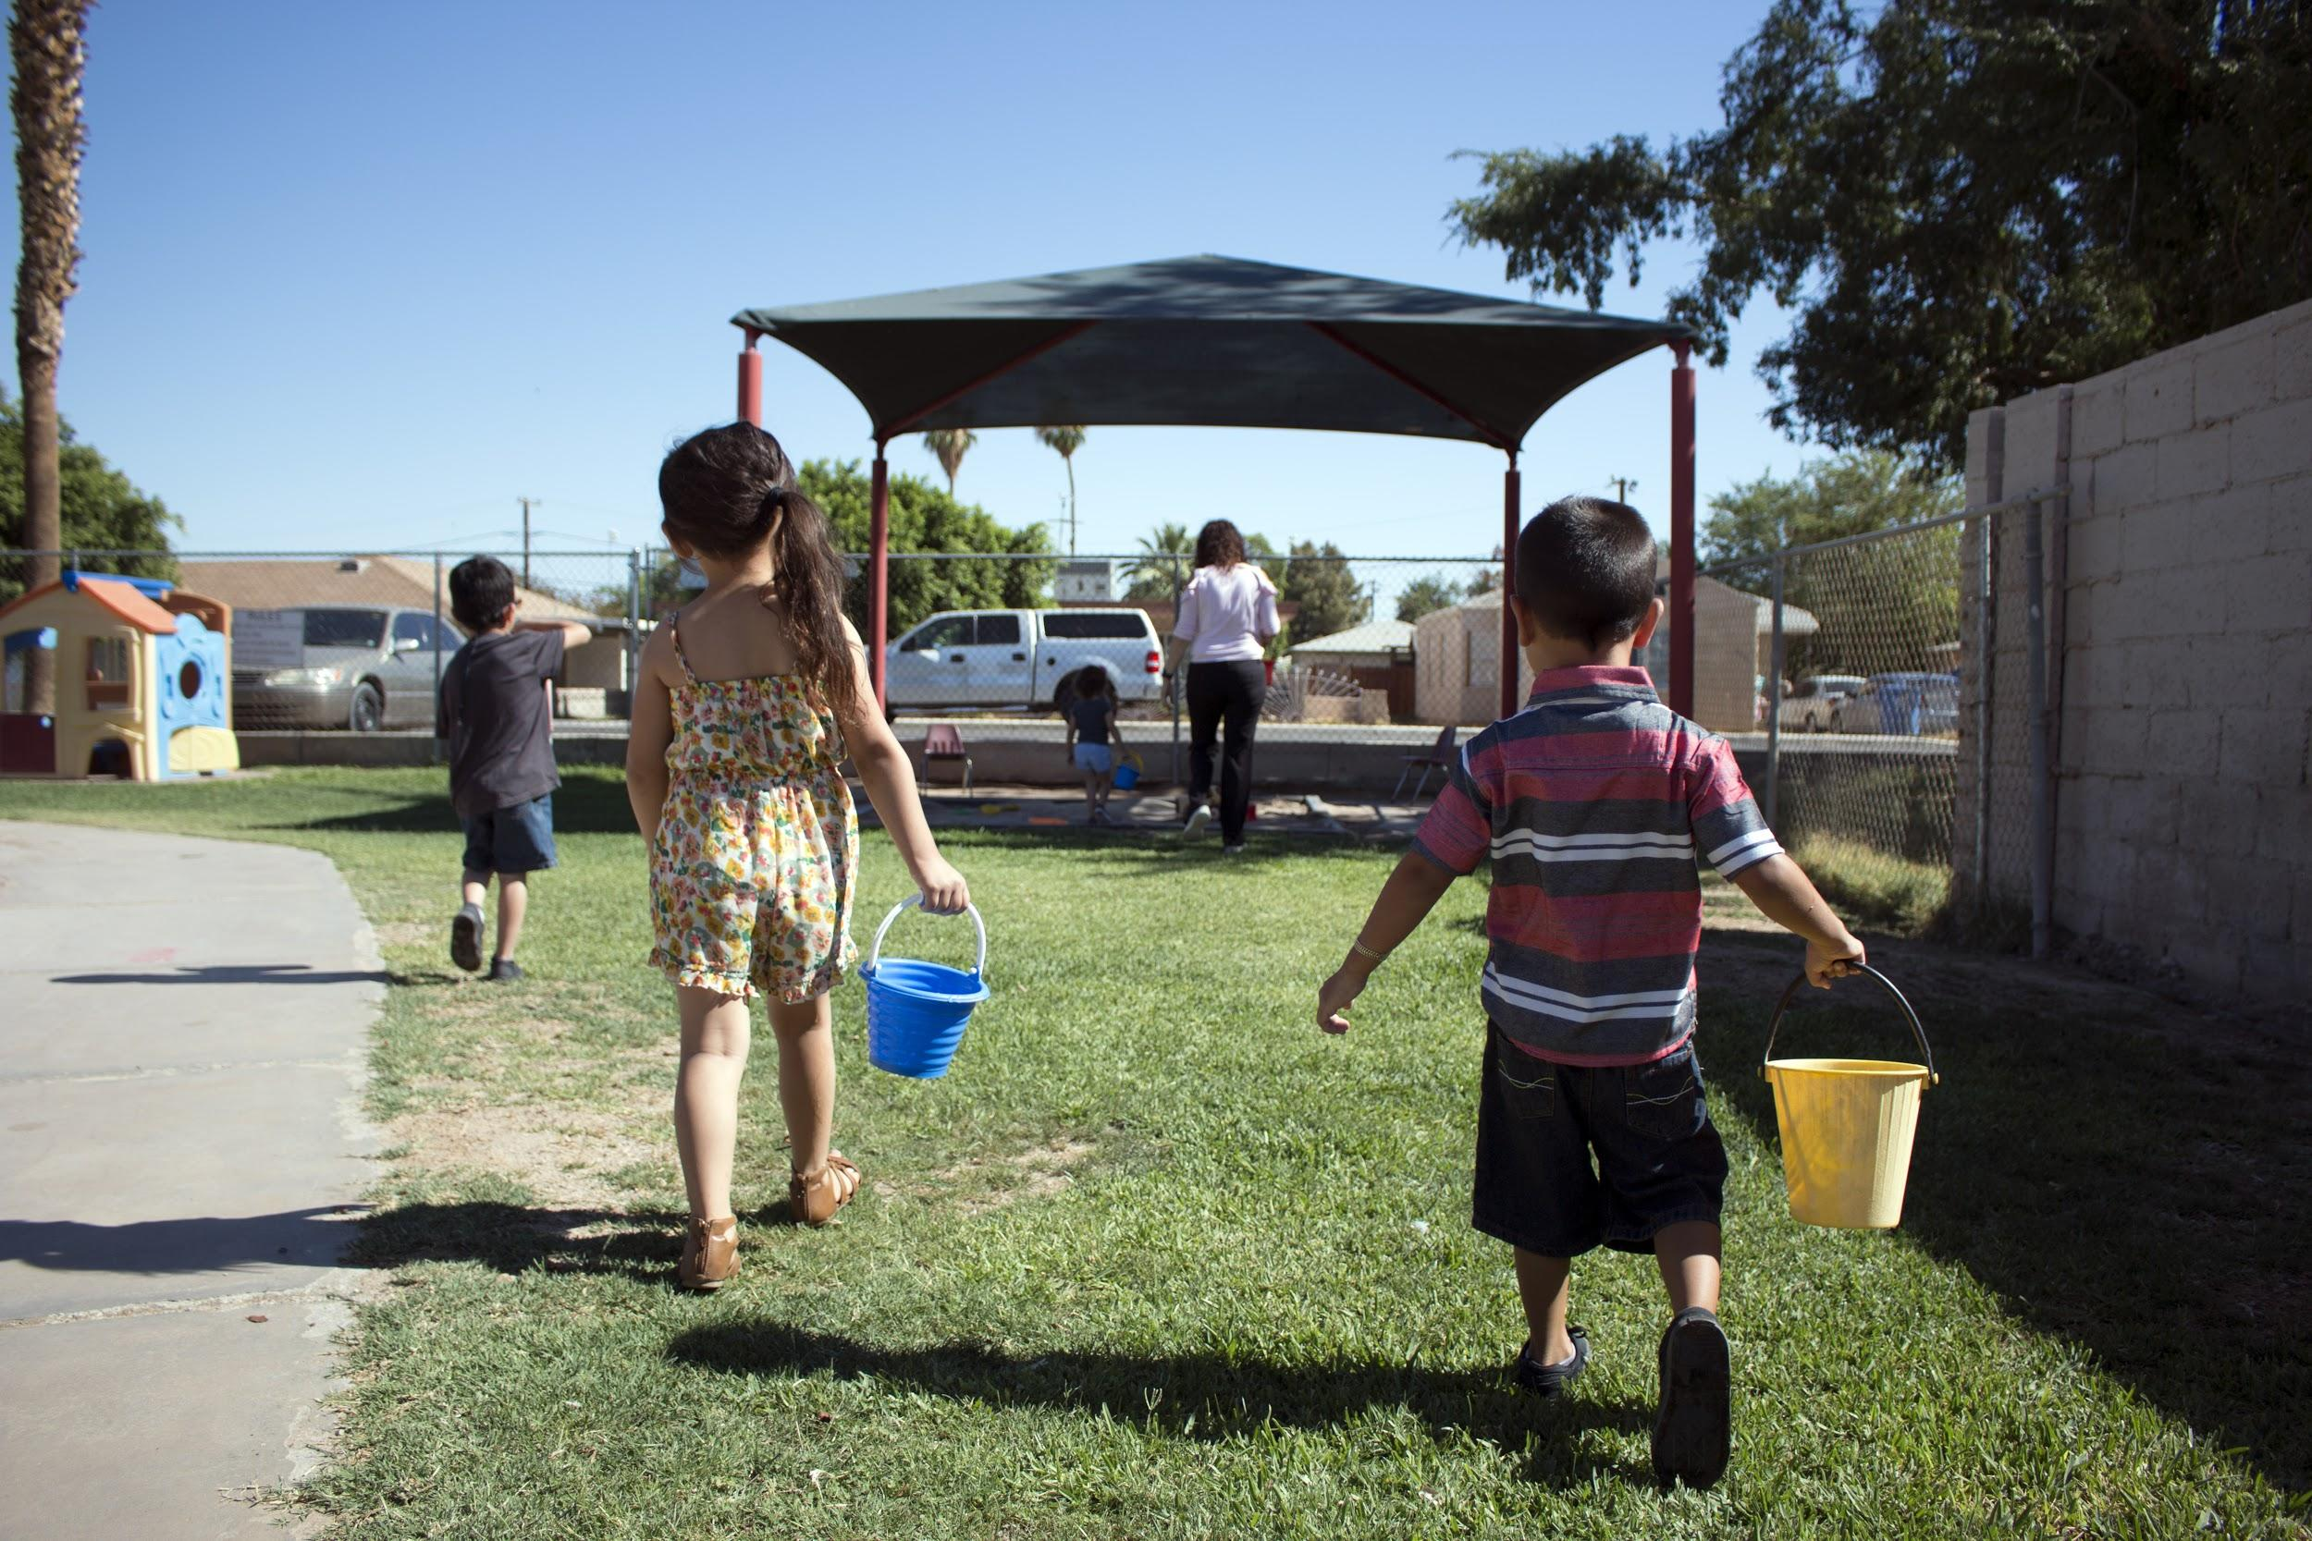

Slide 7
What is this training about?
Explain to participants that:
We want to help you and your kids be as active as you want to be
We are going to ask you questions about what you and family do when you’re not working
Together, we will come up with easy ways you can be more active with your family, all together!

Slide 8
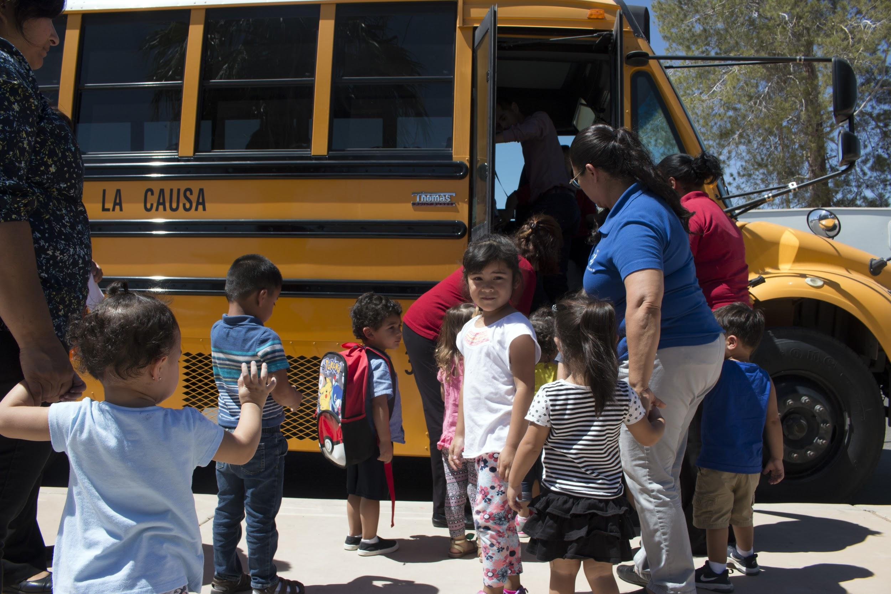

Slide 9
Thinking About Your Day
Materials
-Music (from your phone, a radio, etc.)
Ask participants to make themselves comfortable, allowing them to stretch out, and create extra space. As they situate themselves, play calming background music (optional).
Ask them to close their eyes and think silently about their after-work hours:
Imagine what you are doing as you finish up your work day and are heading to pick up your child/children.
Where is your child being cared for as you work? Imagine what happens as you collect your child to return home at the end of the day
Once you arrive home, what do you do?
Who prepares dinner, and how?
Imagine one of your best evenings or moment in the evening with your child.

Slide 10
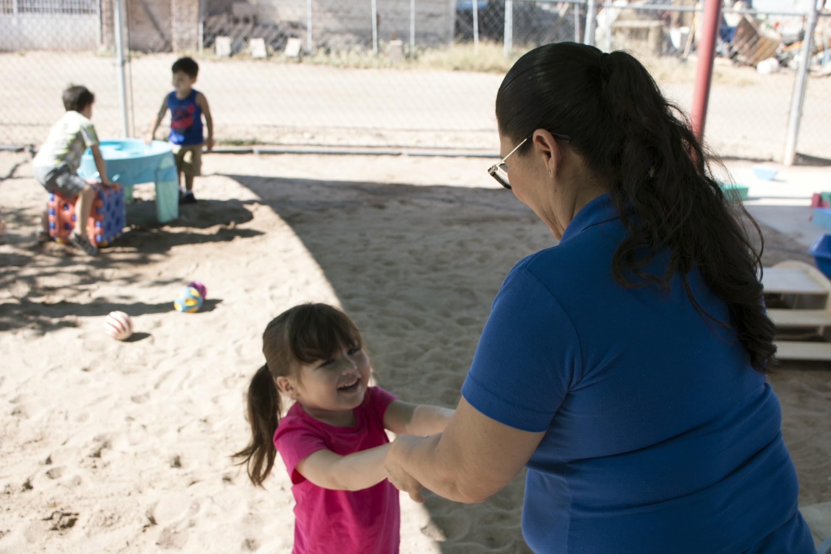

Slide 11
Group Sharing
Ask the participants about the exercise
Was this exercise difficult? If so, why? What did you enjoy about the activity?
Which parts of your day were easiest to imagine? Which moments felt the calmest and most satisfying? Why?
Which part of your day is the most challenging? What is going on in these moments?
Can you share a story about what your morning looks like? What are some opportunities for activity before work?
How can you fit being active into your days off?

Slide 12
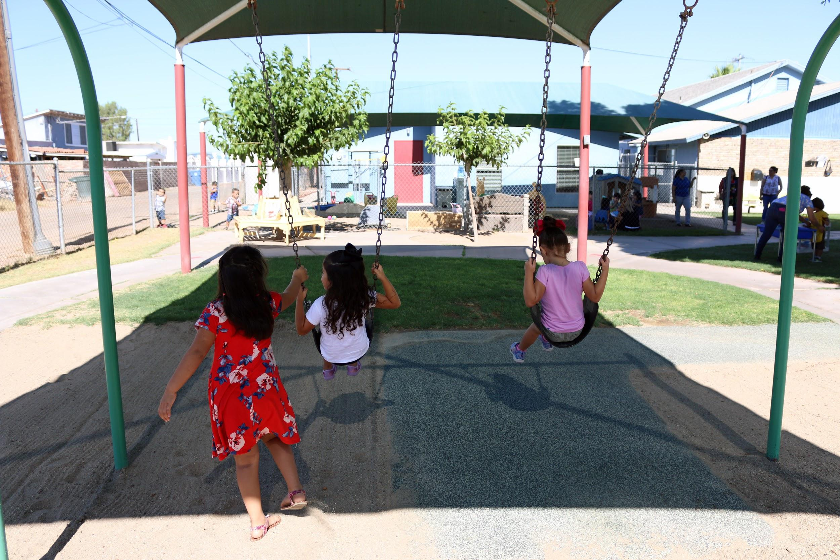

Slide 13
Make Your Map, Part One: Brainstorming!
Explain that participants are going to make a map of their community. Show parents how to create a map (have visual example on the other side). Use a large image of your community or draw a grid to begin your map.
Ask and draw the following questions:
What activities do you and your family enjoy? Where do you go for these activities? Do these activities change throughout the year?
Why is it hard to achieve an active lifestyle? What resources would make it easier? How can community members help each other and share the labor?
What are the organizations in your community that provide support or assistance to families? Please describe. (Instructions continue on next page)
Materials
-Markers
-Paper

Slide 14
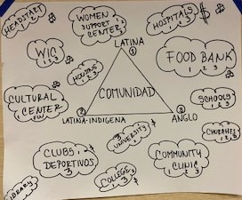
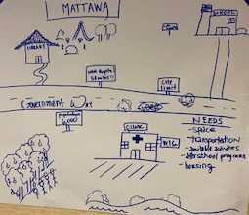
Examples of community maps
Use your creativity and imagination to create a map that best fits your community!

Slide 15
Make Your Map, Part Two: More Brainstorming and Drawing!
Is there easy outdoor access for community members? What kinds of outdoor activities are possible in your community? (parks, walking trails, swimming pools, sports)
How far do families have to travel to take part in outdoor activities?
Are there organizations, school programs that provide opportunities for engaging in exercise for children or adults? What are these opportunities and where are they offered?
What resources are lacking in your community? Are there other towns/cities that offer these resources? Do you have access? If so, how far do you have to travel?

Slide 16
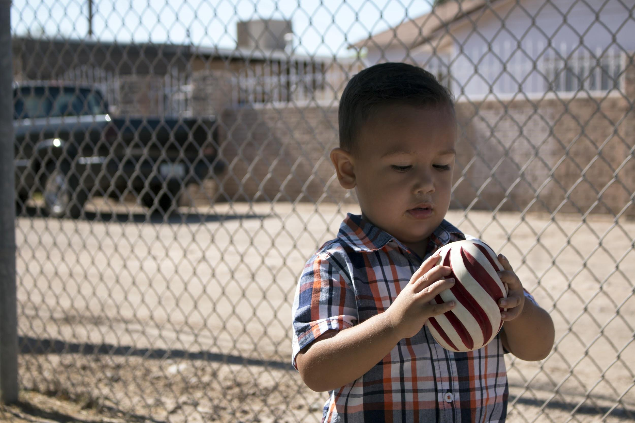

Slide 17
Popcorn Game
Materials
-Music (from your phone, a radio, etc.)
-Inflatable or paper ball
Activity: The facilitator asks questions about the last activity and tosses a ball to a participant to answer. Each participant must shout out their answer before they “popcorn” the ball to someone else.
Questions:
What surprised you about drawing the map?
What places haven’t you visited in a while?
What places or items in the map do you want to use more in the future?

Slide 18
My Week worksheet

Slide 19
Creating an activity plan
Materials
-My Week worksheet for each participant OR large sheet of paper
-Markers
Have participants talk in small groups about their typical after-school/after work activities; then ask about their children’s activities. Trainer writes down their ideas on a large sheet, and then together the group marks which ones incorporate movement or exercise.
Ask participants:
What are three changes you would like to make in your family’s after-school/evening routine?
What are some challenges you might face in making these changes?
What support do you need to be successful in making these changes?
a. Circle parts of the day where there are no activities
b. Ask participants what types of activities they might be able to do during these gaps!
Pass out “My Week” worksheet to participants and explain how they can use this resource at home.

Slide 20
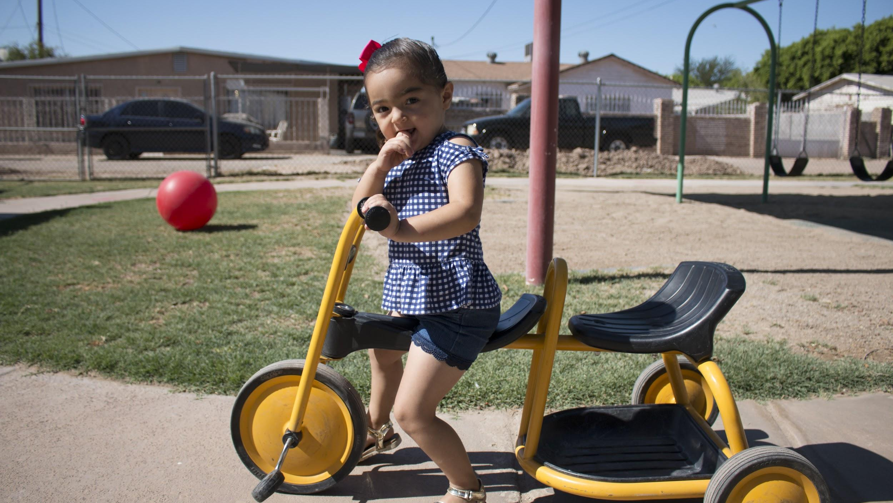

Slide 21
Group Reflection
Once participants have created their new plans, ask them to join together as a large group.
Ask participants the following questions, and write down ideas from the large group discussion:
Why is it difficult to add more activity? What are some challenges to moving more?
How can you change your day to add more activity?
How can you collaborate with other parents to add more activities together?
What support do you need to successfully make these changes and keep them up?

Slide 22
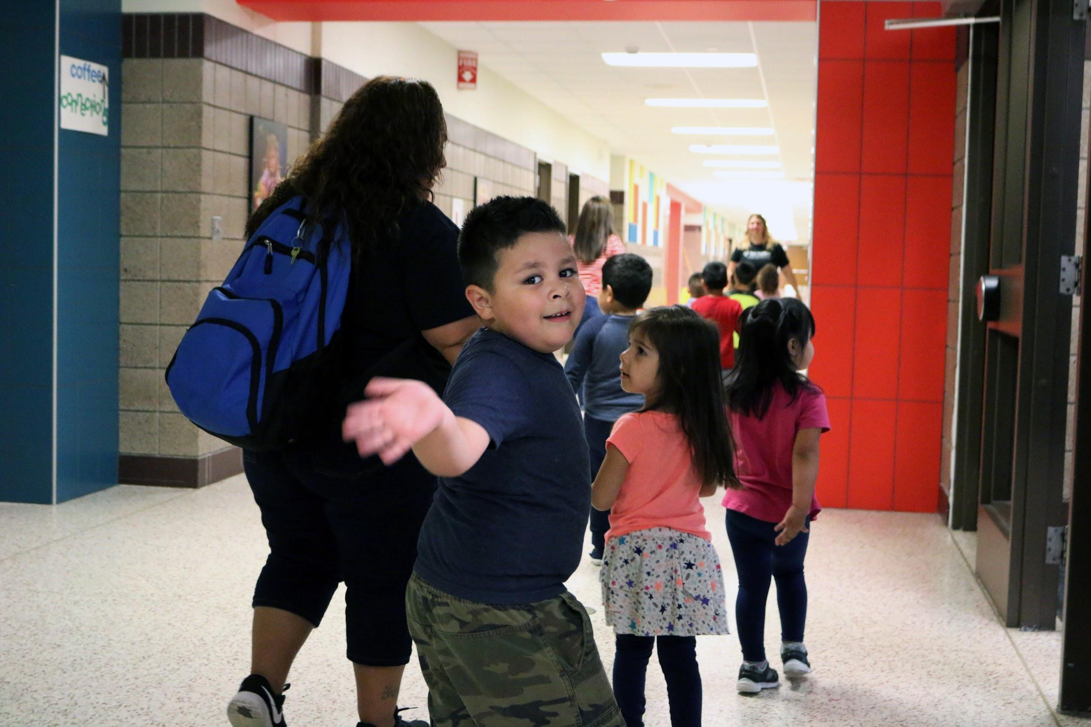

Slide 23
Closing
Summarize the goal of the training
Now parents can envision places, times, and ways they can be active with their children.
They have an additional resource (“My Week” chart) to think creatively about their day.
Invite parents to share:
a moment they enjoyed from the training
something they wish had been included in the training
something that they learned
one piece of their day they will change as a result of the training

